Slide 1
Computational Science
Week 2

Slide 2
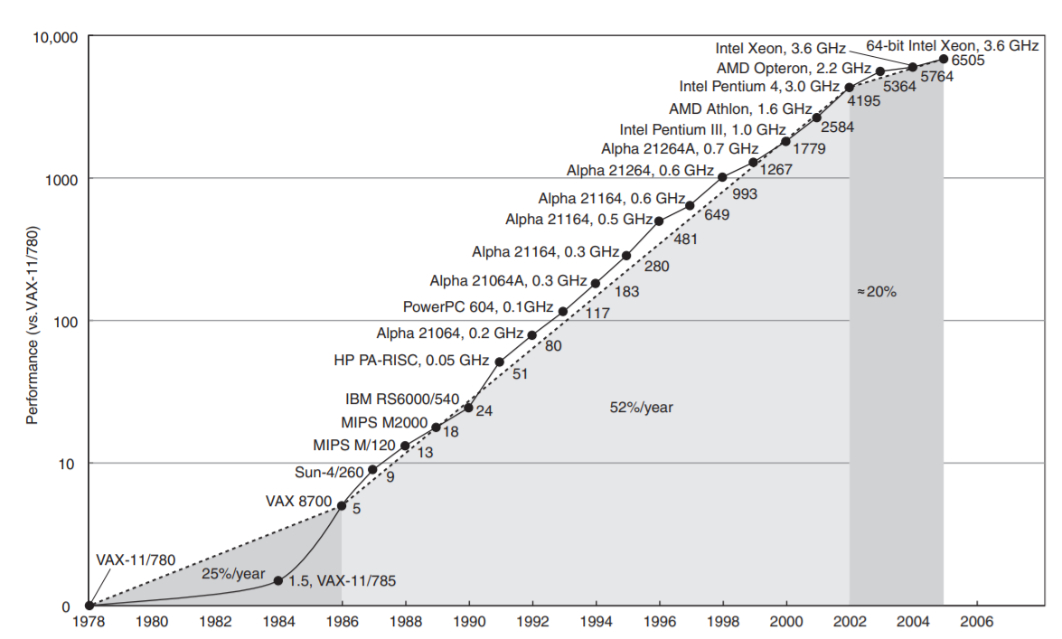
History of Performance
Source: http://www.cs.columbia.edu/~sedwards/classes/2012/3827-spring/advanced-arch-2011.pdf
Notes:
TCP/IP Transmission Control Protocol/Internet Protocol - Allows computers to communicate at long distances

Slide 3
Over the years, our innovative capacity have led to cheaper computing.

Slide 4
With this much of computing power, where can we use it for?

Slide 5
With this much of computing power, where can we use it for?
To better understand our world

Slide 6
Computation Science is a versatile field which can be used in the following areas:
Virology e.g. HIV and Hepathitis C
Meteorology e.g. Weather Forcast
Ecology e.g. Predator and Prey
Linguistics e.g. Roots of languages
Seismology e.g. Earthquakes simulation

Slide 7
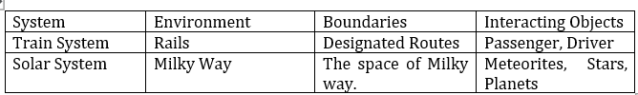
In Computational Science, modeling and simulation can be used to achieve our purpose.

Slide 8

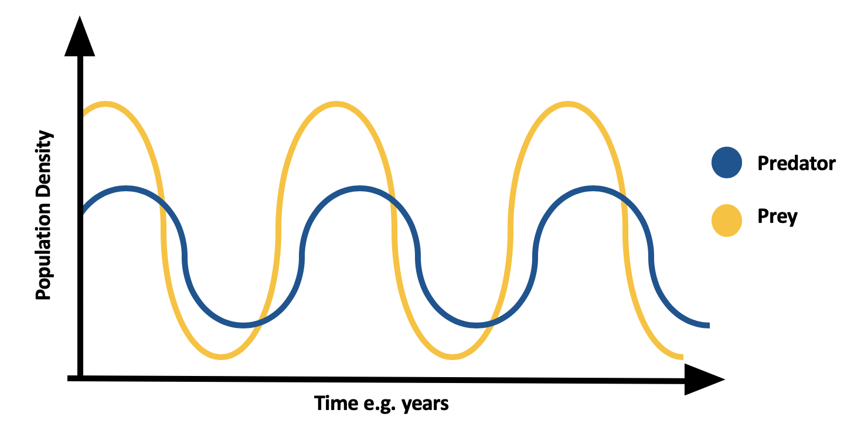
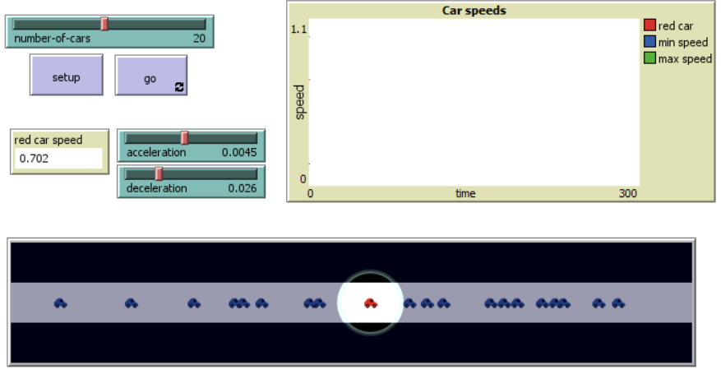
Types of Models
Physical Models
Mathematical Models
Computer Models

Slide 9
Model Classifications
Stochastic vs Deterministic
Static vs Dynamic
Continuous vs Discreet

Slide 10
For this topic, we will only be discussing two model types:
Mathematical and Computer Models

Slide 11
STEPS of the Modeling Process
Analyze the Problem
Formulate the model
Solve the model
Verify and Validate
Report on the model
Maintain the model
Quotes for illustration purposes only

Slide 12
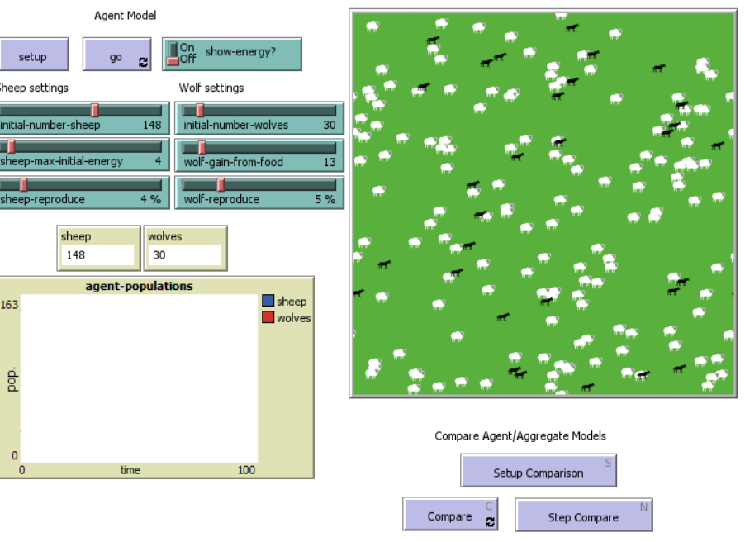
Predator and Prey
Analyze the Problem
Formulate the Model
Solve the Model
Verify and Validate
Report on the Model
Maintain the Model

Slide 13

Any questions?

